Slide 1
Update progress 2025/05/20 By: Krit ittisomboon (クリット イティソンブーン) (Hymn) (ヒム)

Slide 2
Progress
Collect Data of Echo Data near BKK/VTBS as a code.
Starting code of taking flight data.

Slide 3
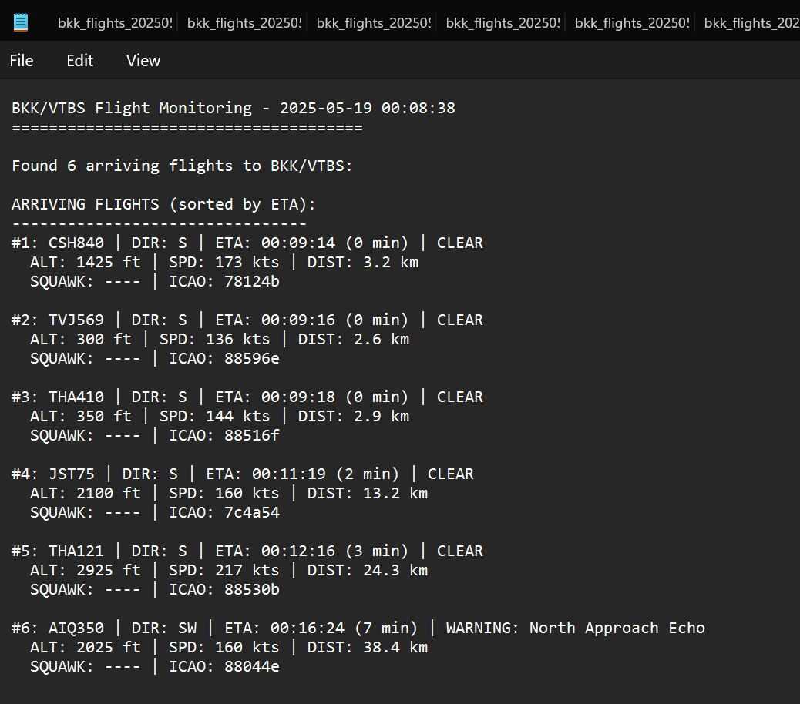
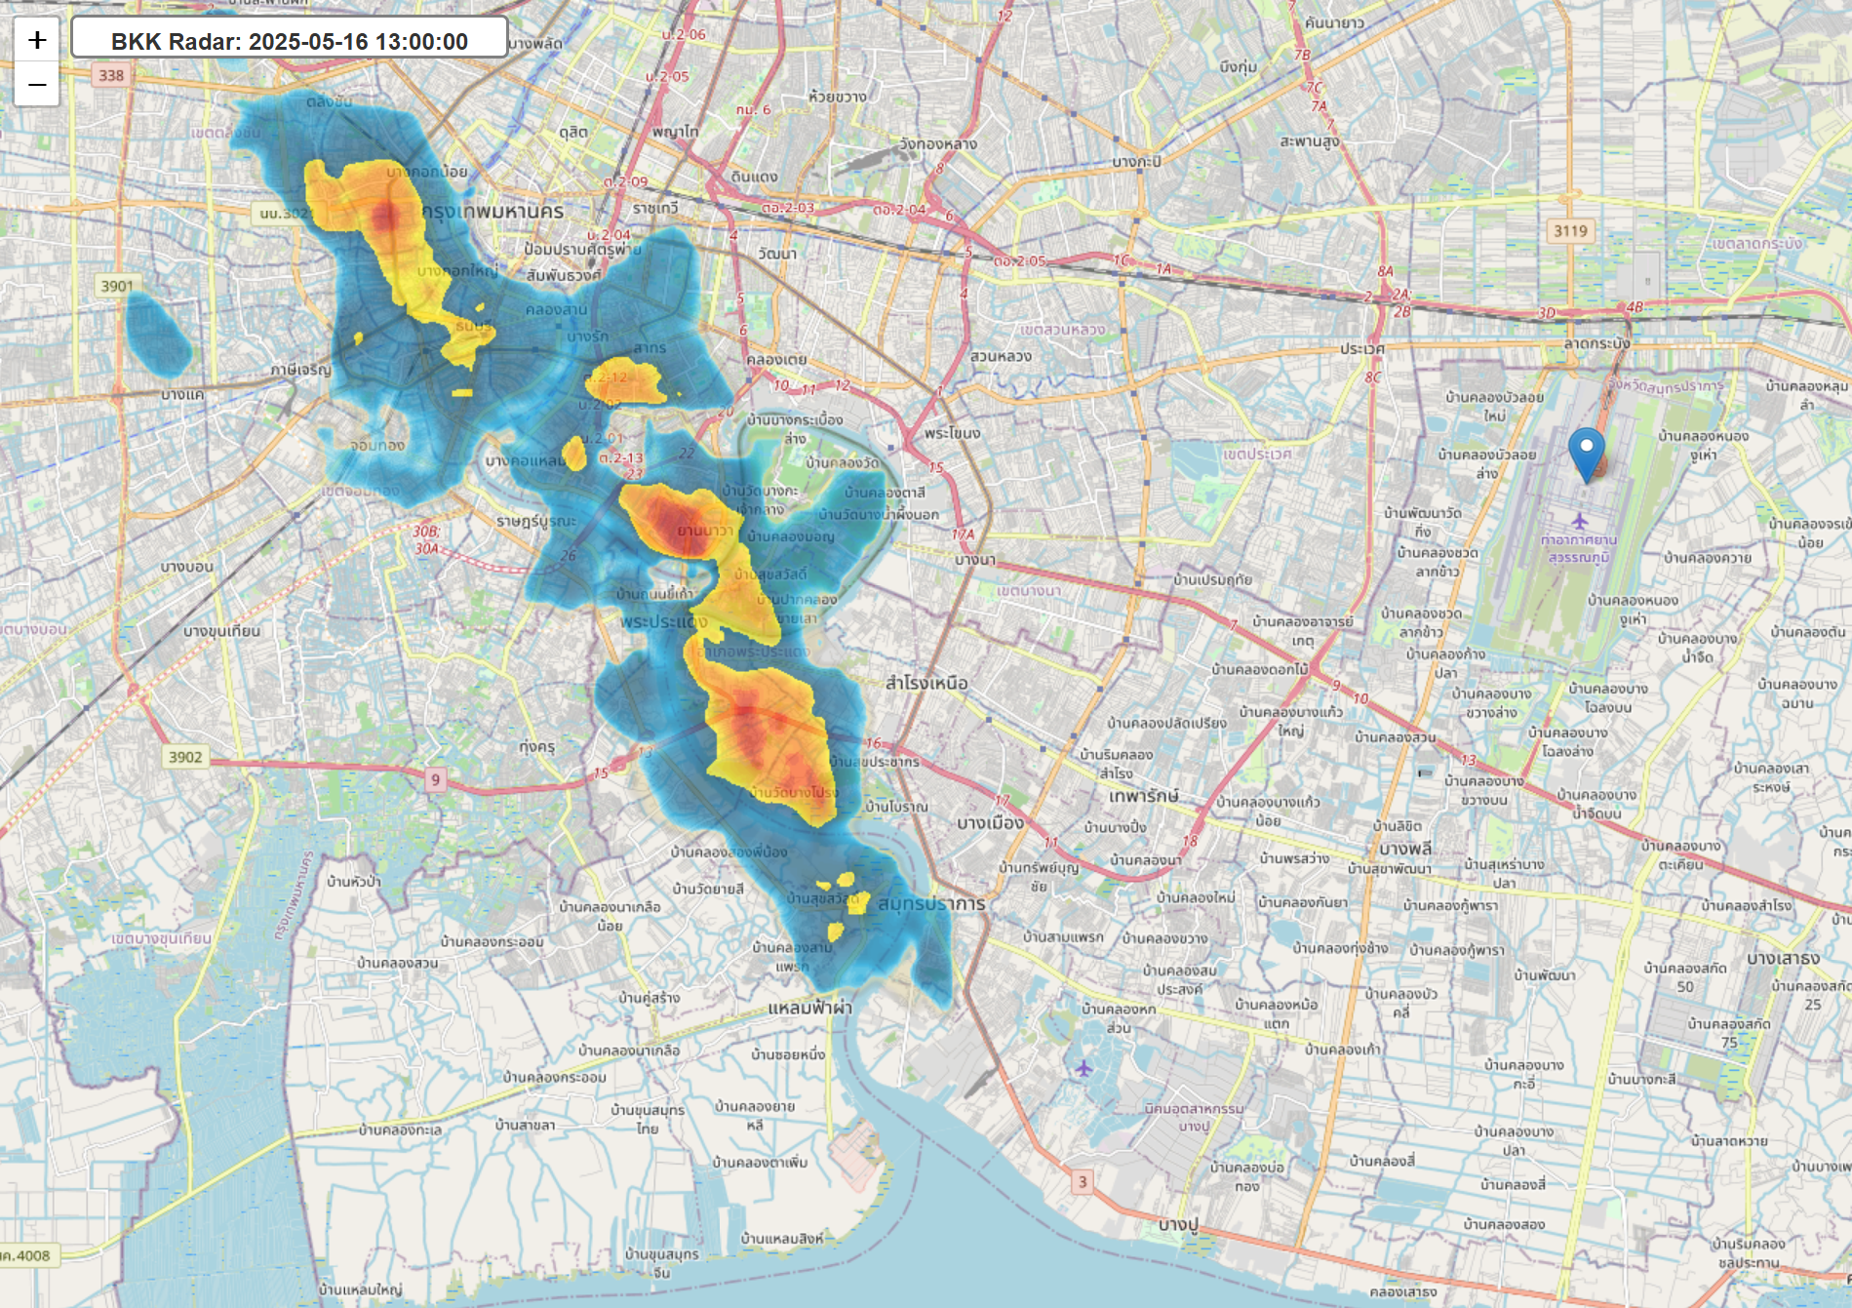
Result
Arrange Echo data as a file organized by date.
Code of echo data that retrieve data as a map but the data will lose in some few days.
Save flight arrivals data as JSON file and TXT file for easy reading.

Slide 4
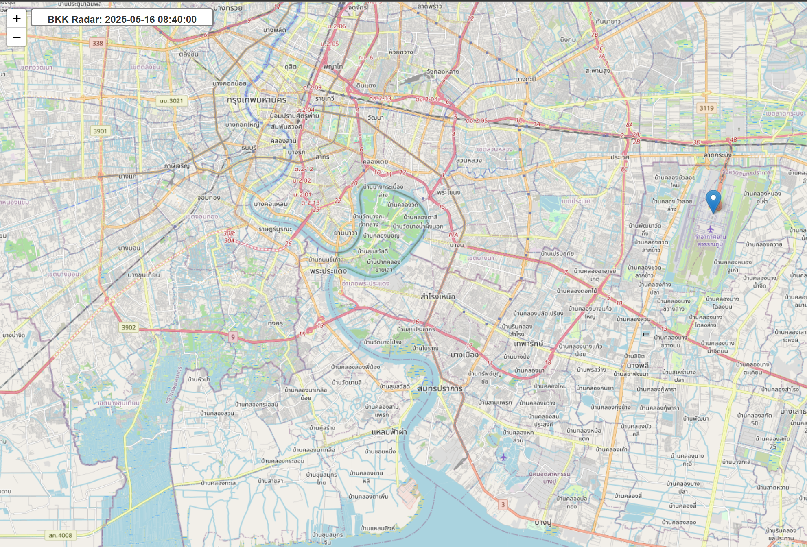
Problem
Saving Flight Data can be saved only real-time flight.
Echo Data lost when past some period of time.
We need to open the computer all the time to collect data because data need to be collect at real-time.
Some Flight data appears to be misunderstand (Ex. Mistake of arrival and departures)

Slide 5
Future work
Find how to take echo data all the time without opening computer all day long.
Fix of the lost of echo data.
Fixing code of taking flight data to get more accurate and precise.
Quantify qualitative weather avoidance decisions by pilots and air traffic controllers—such as measuring distance to weather echoes and deviations from flight paths.

